Slide 1
Culture Change
Engaging employees during large scale change
Bank of America Case Study

Slide 2
Before we begin…
How do we define culture?
Practices
How we foster and reward desired behaviors through organizational practices…
Values
What we stand for…
Behaviors
The way we do things…
+
+
  Culture
2
Notes:
This presentation contains copyrighted information owned by third parties and is being used pursuant to license in favor of Bank of America.
So, this is just a reminder of how we define culture. It’s a function of 3 things: values, behaviors & practices.

Slide 3















BAC Has Grown Through a Series of Acquisitions…
1985
1990
1995
1999
2004
2006 - 08
Florida
South Carolina
Notes:
Bank of America
9/22/11
Presentation Template
3
As each of you know, our company has experienced significant growth through mergers and acquisitions. In each of these, we have relied on our values and our leaders who live by them to lead through change and deliver the most value to our customers of the combined organization.
We know that change is challenging. We have goals we are held accountable to attain and a track-record of proven success in merger integration.
We are confident that we are going to achieve the same quality integration with this transition as we have done in the past.
Arguably, however, this transition is the most complex in our history. If we just take the environment we are working in, you could make that argument. Combing the external environment with the internal complexities makes our challenge more significant. Therefore, our leadership must be collective. Our leadership must enable us to integrate effectively and deliver value quickly. It is our responsibility.
[CLICK]

Slide 4
Topics for today’s discussion
It’s all about the strategy
The writing on the wall
Building blocks for culture change
Driving adoption
Smart partnerships
The tangibles
Lessons learned
Where we are in the journey

Slide 5
It’s all about the strategy
Our Vision:
To become the world’s finest financial services company as defined by our shareholders, customers and employees
Our strategy to achieve the vision:
To Serve 3 Groups of Customers: Consumers, Companies & Individual Investors
To Focus on Their Core Financial Needs
With Best-in-Class Capabilities
To Meet Their Global Needs
And to Deliver the Franchise to Every Customer

Slide 6
New era for Bank of America:
The writing on the wall
Building / acquiring franchise
Operating the Franchise
U.S.-centric, commercial bank
Global financial firm anchored in U.S.
Selling products
Building relationship depth
Customer acquisition
Customer retention and deepening
Size and scale
Returns

Slide 7
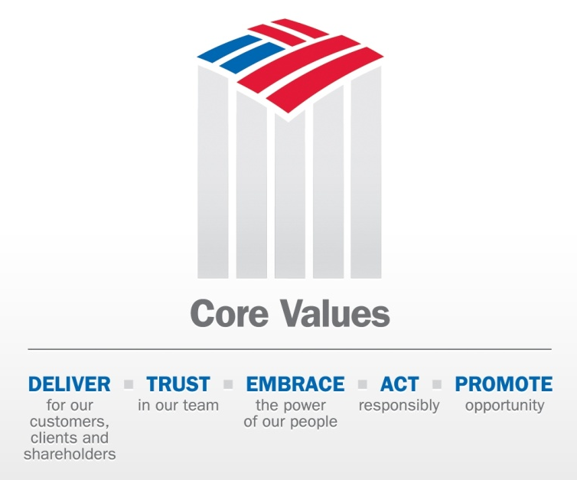
Building blocks for culture change
  Operating Principles
  Core Values
Customer-driven
Operational excellence in both efficiency and risk management
Fortress balance sheet
Deliver on shareholder value proposition
Clean up legacy issues
Best place for people to work

Slide 8
Driving adoption
Adoption
“Know-How”
Superior
Understanding
“Know-Why”
Competency models
Performance management
Talent Planning
Multi-rater feedback
Business Results
Awareness
“Know-About”
Training programs and curriculum
Manager Discussion Tools
Public Recognition
Enterprise and LOB communications
LOB leader visibility
Intranet content / messages
Current
Low
Adoption Over Time
High

Slide 9
Smart partnerships
Enterprise resources develop
strategy and supporting resources
Project Sponsors
Provide guidance and support to the core team
Communications
Design enterprise messages and communications tools for CEO, Senior Leadership and Manager use
Leadership Development
Create tools and resources to drive understanding and adoption; integrate the behaviors and norms in all necessary processes
Brand / Marketing
Facilities
Provide direction on external marketing impacts and internal branding to reflect the new values
Identify those aspects of our building and facilities which are affected by the new values
LOB resources drive implementation and adoption
LOB Leaders
LOB Support Partners
LOB Managers

Slide 10
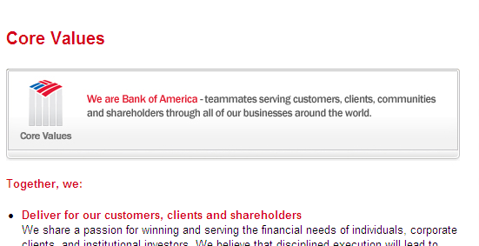
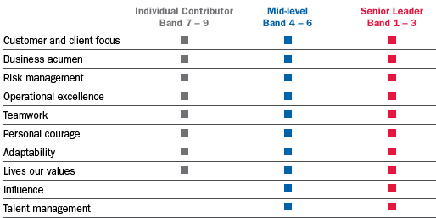
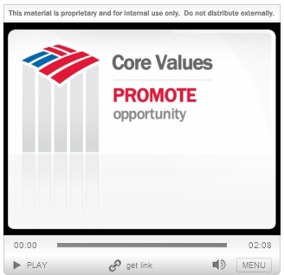
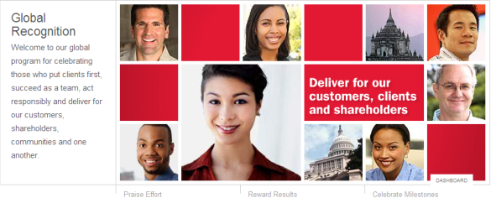
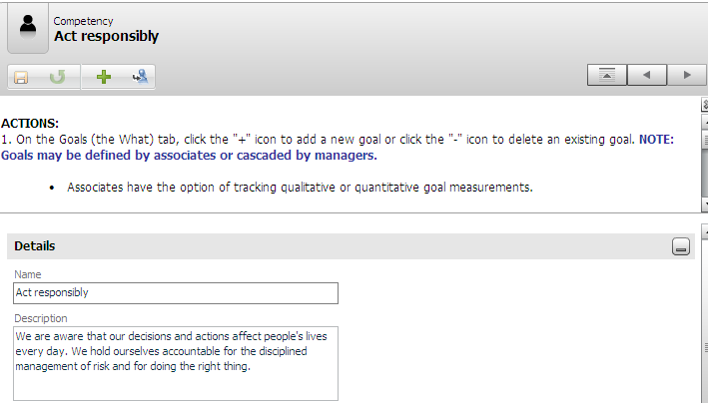
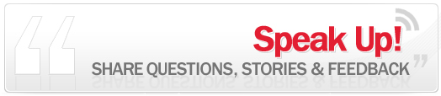
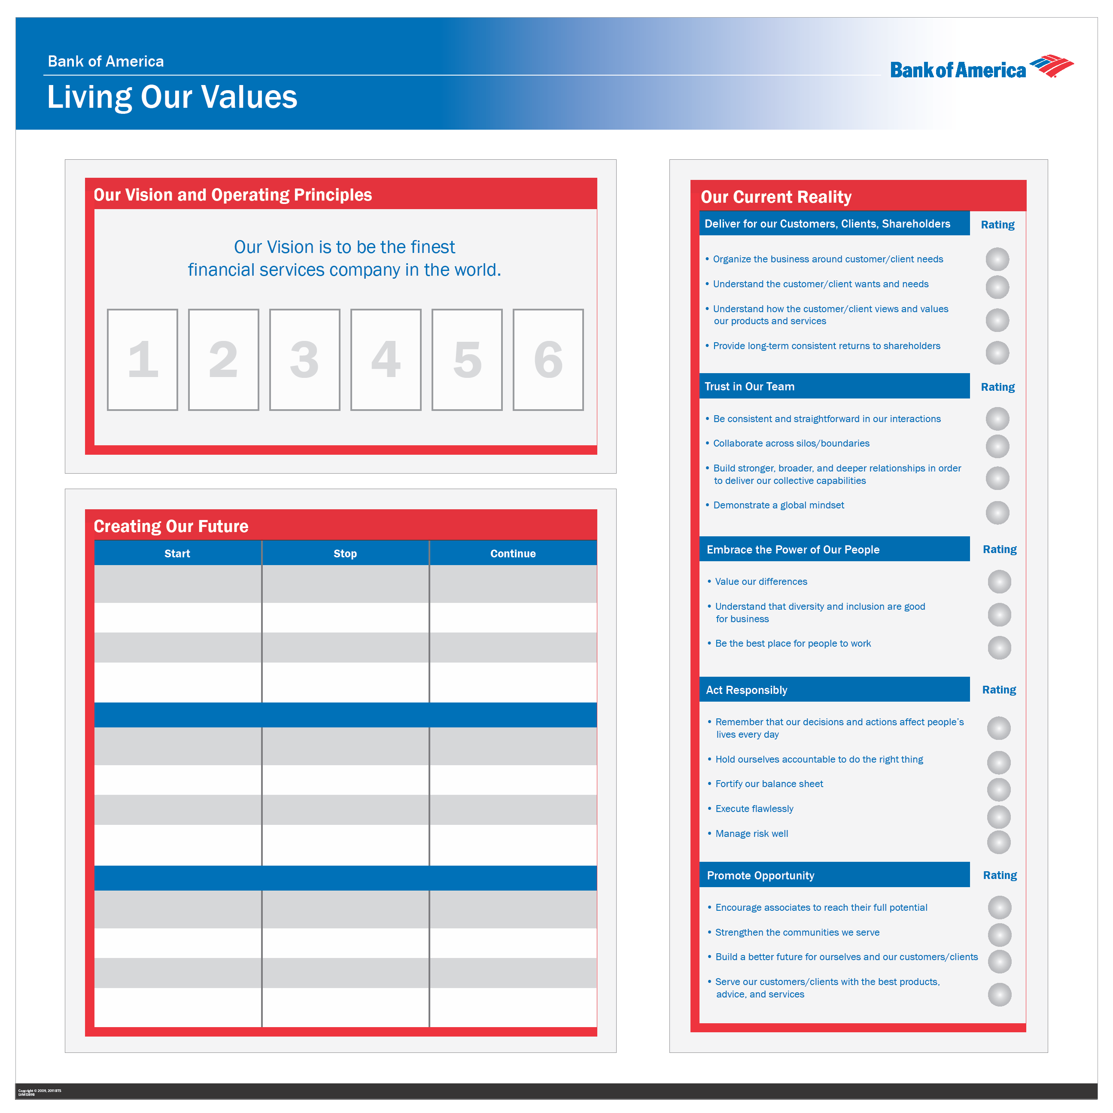
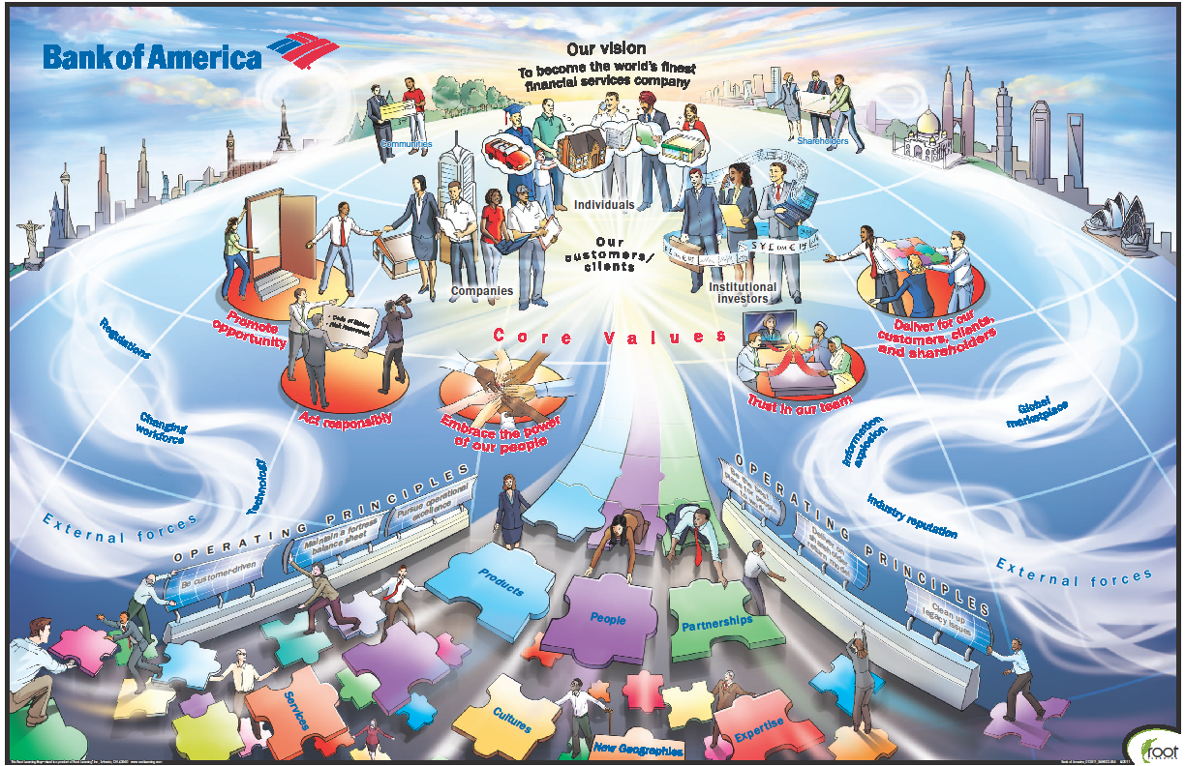
The tangibles
Awareness
“Know-About”
Understanding
“Know-Why”
Adoption
“Know-How”

Slide 11
The employee’s view
Awareness
“Know-About”
Understanding
“Know-Why”
Adoption
“Know-How”
Received e-mail announcement of new Core Values
Watched videos on intranet site of Senior Leadership Team describing our strategy and values
Attended All Hands call where my leader discussed why Core Values are important to my line of business
Received Manager Bulletin with resources that I can leverage in team discussions
Attended training session where Strategy & Values Learning Map was conducted
Led team discussion on what Core Values mean to us and actions we can take to live the values
Reviewed Leader Model competencies with my leader to understand expectations
Linked actions on my Performance & Development Plan to specific Core Values
Received feedback on my demonstration of Core Values via 360 feedback process

Slide 12
Lessons learned
Senior management must define up front what is not open for negotiation.
The initial “big bang” is only the first step in ongoing management of the change.
Employees need to repeatedly hear and see the change for it to register.
Identify your “connectors” and enable them with simple, relevant tools.
Our leaders define and drive our culture and must model desired behaviors.
Adoption is an ongoing process that can take two years or more.

Slide 13
New era for Bank of America:
Where are we?
Building / acquiring franchise
Operating the Franchise
U.S.-centric, commercial bank
Global financial firm anchored in U.S.
Selling products
Building relationship depth
Customer acquisition
Customer retention and deepening
Size and scale
Returns

